Slide 1

Project Title - Seasonal Agriculture Performance Analysis
Name : Krishna Chakraborty
collage name: Techno India University Tripura
AICTE STU ID : STU676c2dd485cba1735142868

Slide 2

PROBLEM STATEMENT
Agricultural activities are influenced by seasonal variations in environmental conditions, farming practices, resource availability and market conditions. As a result, agricultural performance may differ from one season to another. However, raw agricultural data does not clearly explain how agricultural performance changes across seasons or what patterns can be observed in different seasonal conditions. The problem is to analyze the given agricultural dataset and investigate seasonal differences in agricultural performance by identifying meaningful patterns, trends, relationships and variations within the available data.

Slide 3
Project Description The Seasonal Agriculture Performance Analysis project focuses on analyzing agricultural data across different seasons, regions, and farming conditions. The project examines factors such as crop production, resource usage, environmental conditions, and economic performance to understand how they vary across seasons. Using data cleaning, exploratory data analysis, statistical techniques, and visualization, the project identifies important seasonal trends, patterns, relationships, and variations in agricultural performance. The analysis helps generate data-driven insights and recommendations that can support better understanding, planning, and decision-making in seasonal agriculture.

Slide 4

WHO ARE THE END USERS?
Farmers
Agricultural Policy Makers / Government Bodies
Agricultural Researchers and Scientists
Insurance Providers
Agricultural Extension Officers
NGOs and Development Organizations
Students and Data Analysts

Slide 5

Technology Used
Platform: Google Colab
Programming Language: Python
Libraries Used:
Pandas
NumPy
Matplotlib
Seaborn
Dataset Format: CSV
Storage: Google Drive
Documentation: Jupyter Notebook (.ipynb)

Slide 6
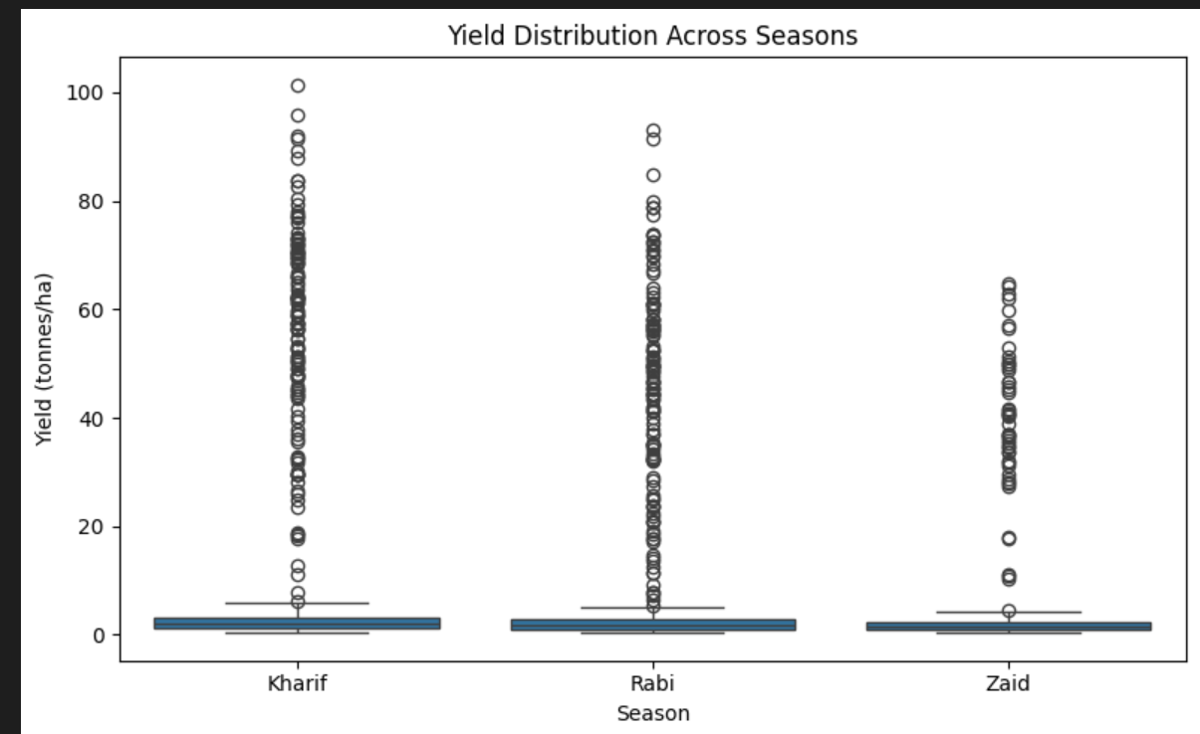
RESULTS
Consistent Growth: The blue boxes at the bottom are completely flat. This tells us that for most regular farms, crop growth stays very steady, predictable, and safe across all three seasons.
High-Risk, High-Reward: The long vertical trails of circles in the Kharif and Rabi seasons show a lot of volatility. It is a gamble—some farms hit a massive jackpot harvest, while others are stuck at a basic average.
Natural Weather Ceiling: The Zaid season has the shortest line of data points. This proves that the extreme summer heat creates a strict barrier, stopping crops from producing past a certain point no matter what the farmer tries.

Slide 7
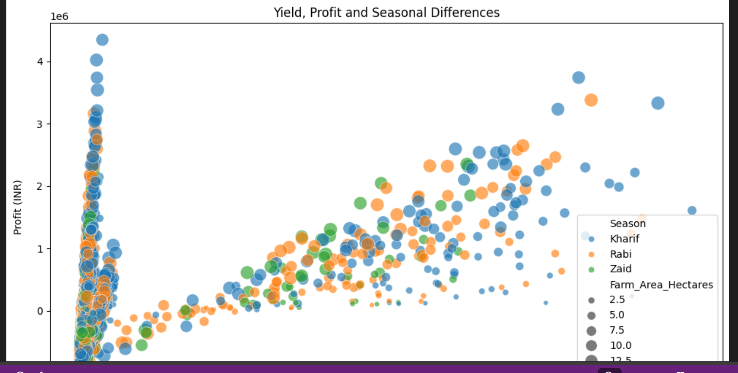
RESULTS
High Risk of High Expenses: the dots are scattered everywhere instead of forming a clean line. This proves a huge risk growing a massive amount of crops does not guarantee a high profit. If operational costs (like seeds, labor, or water) spike during that season, the expenses can wipe out the money from a great harvest.
Consistency of Scale: This graph shows that large farm sizes have a highly consistent advantage; they can handle seasonal price risks much better than small farms and secure the highest profit brackets.

Slide 8
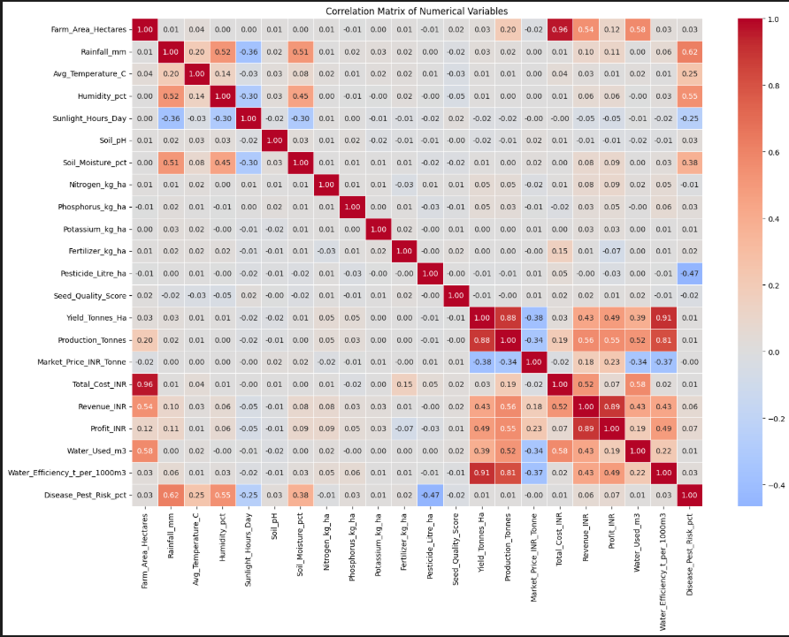

RESULTS
The data clearly shows that water and crop weight move together. If you want a massive harvest, you must have a reliable, steady watering system. Without enough water, your crop volume simply will not grow.
Making your farm too huge actually makes it slightly less efficient. The numbers show that when a farm gets too big, it becomes much harder to manage, and you end up wasting water and resources instead of saving them.
To make a real profit, keeping your daily costs low and picking high-value crops is far more important than just trying to grow a massive amount of crops. High yield means nothing if your bills eat up all your cash.

Slide 9
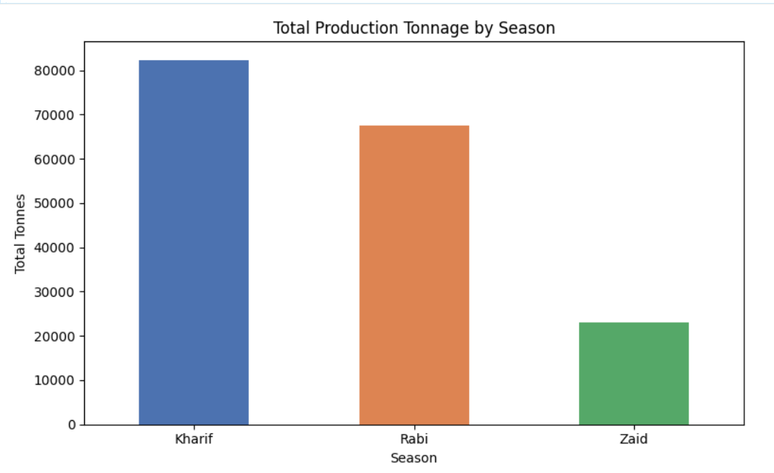
RESULTS
The blue and orange bars are huge. Kharif brings in the highest amount of food (over 80,000 tonnes), and Rabi follows closely behind (around 67,000 tonnes). These two seasons are the backbone of your yearly supply and income.
The green bar for Zaid drops down drastically to just 23,000 tonnes. This is a huge warning sign: trying to push for a heavy harvest during the hot summer months is incredibly difficult and wasteful, mostly because the intense heat and dropping water levels fight against your crops.
Because almost all your crops grow during just the Kharif and Rabi windows, your farm's survival is highly exposed to bad weather risks. If a severe monsoon fails during Kharif, or a winter drought hits your Rabi crops, it will wipe out the entire year’s food supply and income.

Slide 10
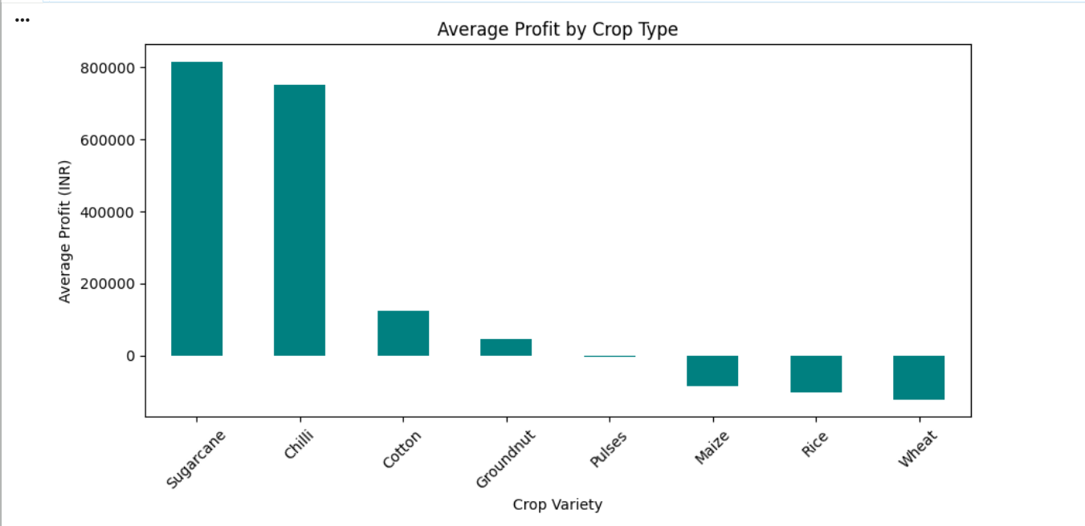
RESULTS
Sugarcane is your highest profit engine , closely followed by Chilli ). These are the absolute best crops to grow if you want to maximize your household income.
Major regional crops like Maize, Rice, and Wheat are actually sitting below the zero line, showing negative average profits. Growing these crops without a government subsidy or perfect weather is a massive financial risk that can drain a farm's savings.
The graph proves that crop choice matters way more than farm size. A farmer on a tiny plot growing Sugarcane or Chilli will make far more money than a huge farm growing fields of Wheat or Rice.

Slide 11
Future scope
If more years of data are added, we can get a better idea of long-term seasonal trends
The same analysis can be done for other regions or states to compare results
In future, machine learning can be used to predict crop yield for upcoming seasons
Adding live weather data would make the analysis more useful and up to date
A simple dashboard could be built so that farmers or officials can easily check seasonal insights
Overall, this kind of analysis can help in planning resources like water, fertilizers, and labor better for future seasons

Slide 12
GitHub Link
https://github.com/Krishnack12/Seasonal-Agriculture-Performance-Analysis.git

Slide 13
VOIS Course completion certificate -

Slide 14
Thank you
.
.

